Slide 1


A Mathematical Introduction to Data Science Lecture 0: Introduction
Yuan Yao
Peking University
2015.4.30.

Slide 2
Short Course Information
Instructor: 姚远
Email: yuany@math.pku.edu.cn
Base Course Website: http://www.math.pku.edu.cn/teachers/yaoy/Fall2014
Ebanshu public lectures: http://www.ebanshu.com/
Time & Venue:
Seminar 1, A Dynamic Approach to Sparse Recovery, May 1, NCTS
Lecture 1, 2, 3: May 5, 6, 7; 3-5pm, 107 Hung-Ching Bldg, NCU
Seminar 2, Applied Hodge Theory, May 8, NCTS

Slide 3
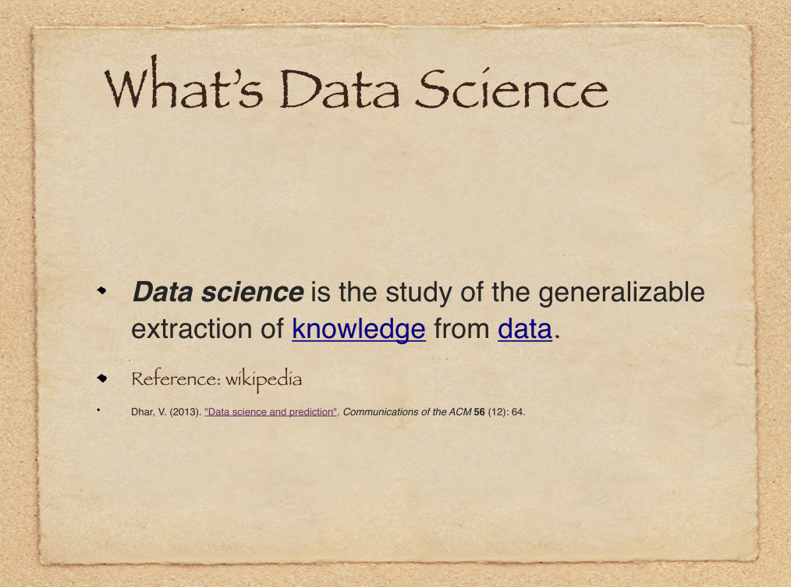

Slide 4
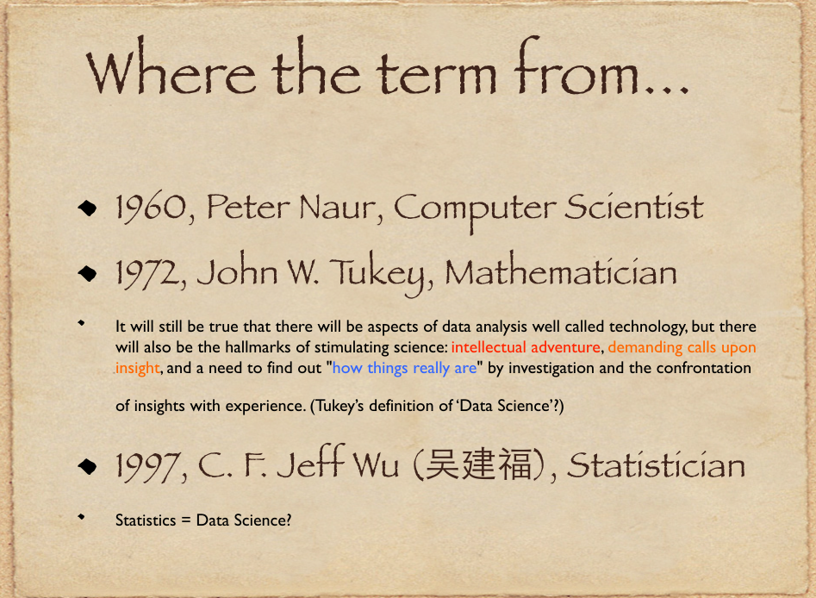

Slide 5
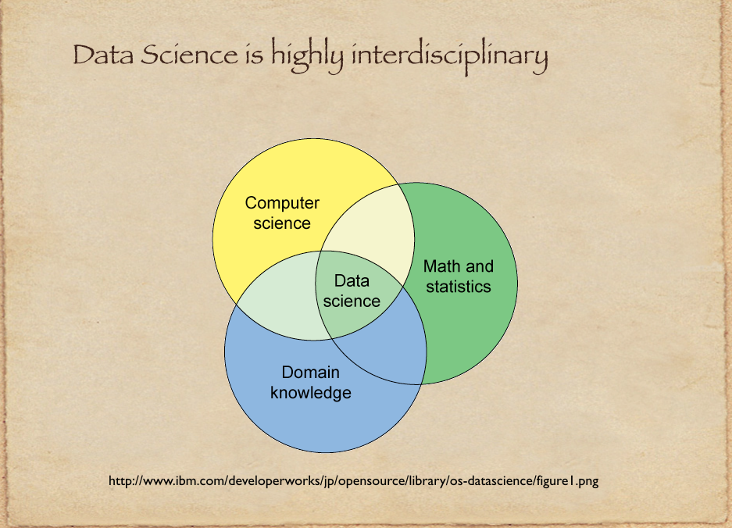

Slide 6
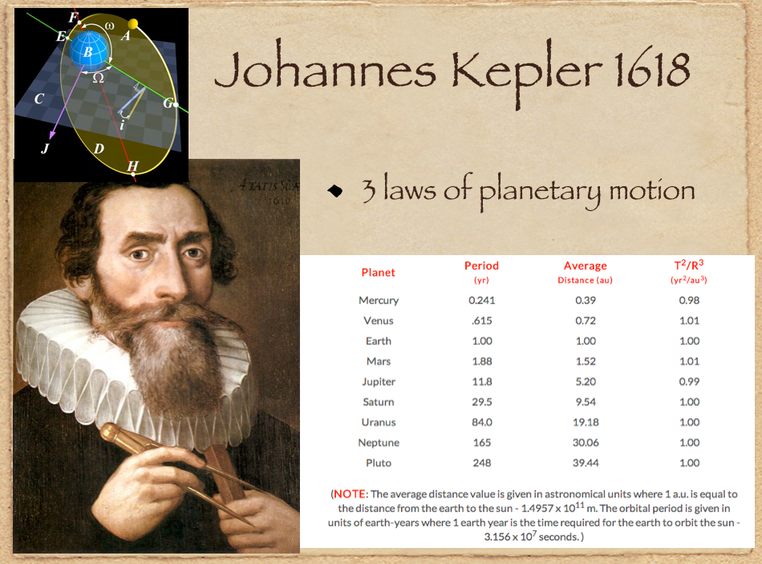

Slide 7
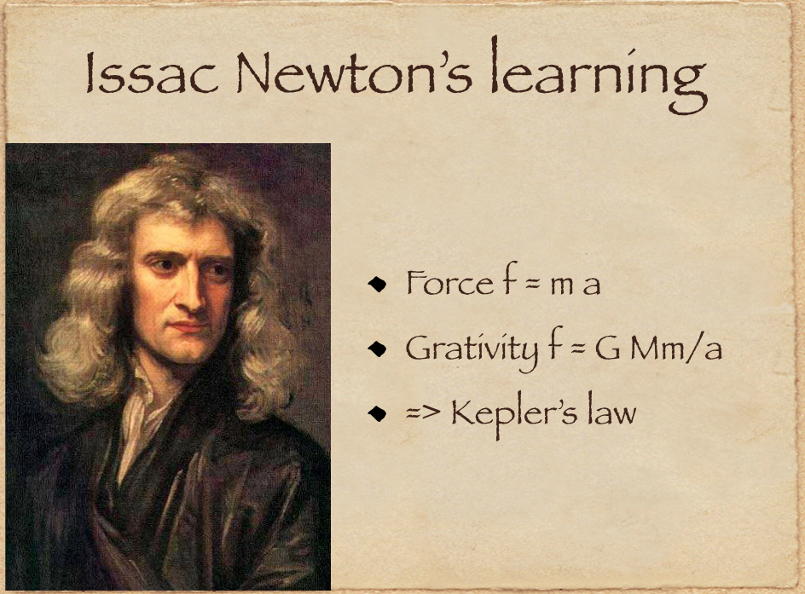

Slide 8
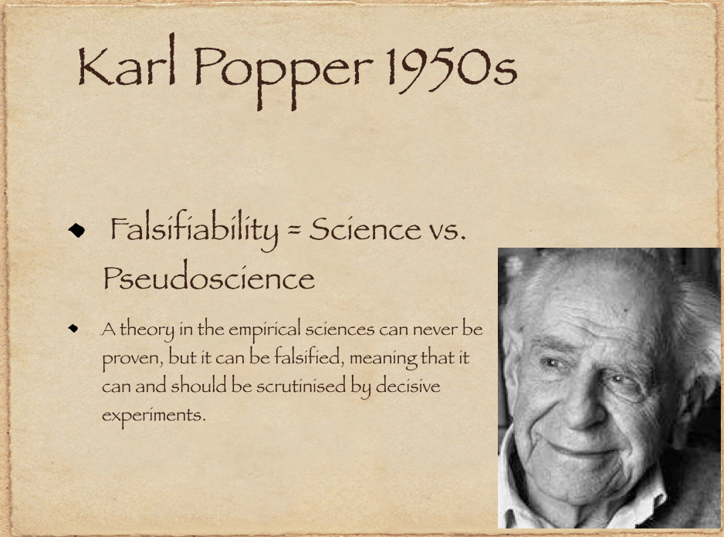

Slide 9
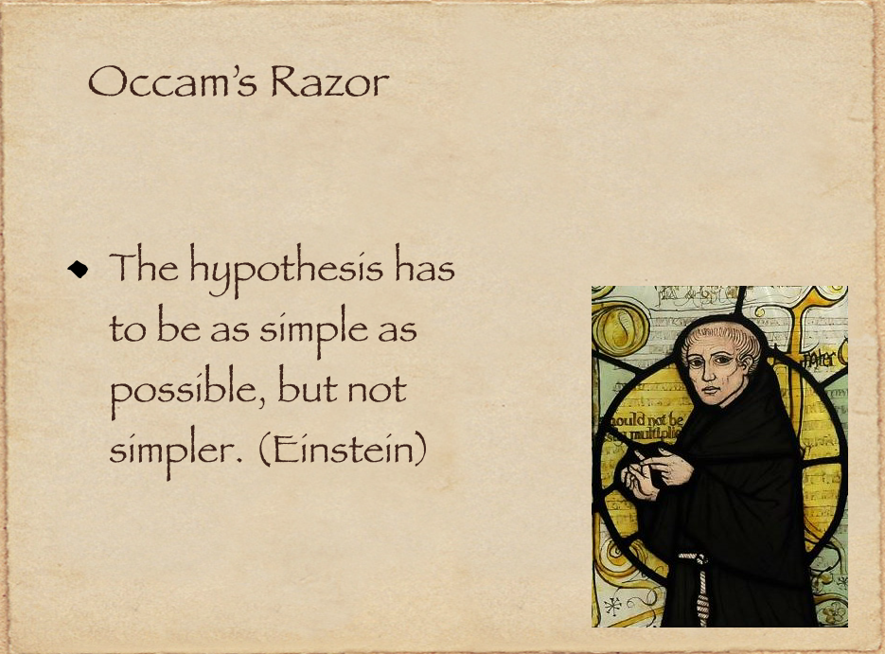

Slide 10
How to Quantify the Falsifiability and Occam’s Razor
Information Complexity for model uncertainty
V. Vapnik, Statistical Learning Theory, 1970s
Kearns and Vazirani, An Introduction to Computational Learning Theory
Yet big data brings up computational challenges…

Slide 11
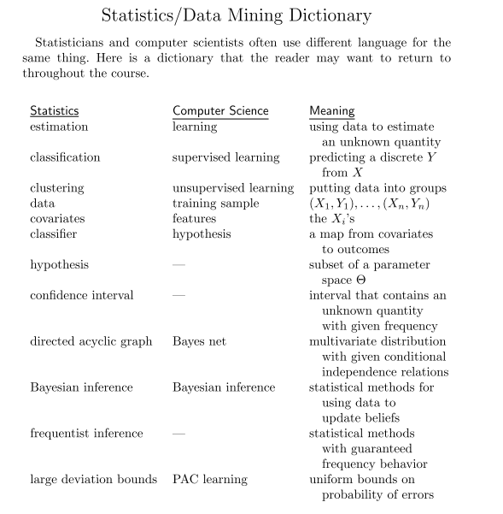
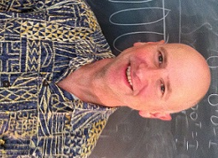
Larry Wasserman in his “All of Statistics”

Slide 12
Data have structures, mathematically universal
Sparsity structure lies in the core of high dimensional data analysis
Low dimensional vector spaces
Low rank matrices, tensors, etc.
Lecture 1: Sample mean and Covariance (PCA/MDS): Fisher’s Principle of Maximum Likelihood Estimate, yet things might go wrong --
Stein’s phenomenon and shrinkage
Random matrix theory and failure of PCA
Lecture 2: Generalized PCA/MDS
Random projections and compressed sensing
PCA/MDS with uncertainty
Nonlinear manifold learning
Lecture 3: topological and geometric structures of data
From graphs to simplicial complexes

Slide 13
Seminar 1: Sparse Recovery or Variable Selection via Differential Equations
LASSO path is biased
Nonconvex optimization/regularization is hard to find global optimizer
A simple dynamics of dual gradient descent of LASSO leads us: model selection consistency with debias, provably under the nearly same condition for LASSO.

Slide 14
Seminar 2: Applied Hodge Theory
Data Analysis on simplicial complexes, extension from graphs
Computer Vision: optical flow decomposition for object tracking
Statistical Ranking: preference aggregation via crowdsourcing pairwise ranking data
Game theory: every finite game admits a direct sum of potential game and harmonic (zero-sum) game

Slide 15
Acknowledgement
Weinan E, PKU and Princeton
Amit Singer, Princeton
Bin Yu, UC Berkeley and PKU
As well as numerous students in the past few years.

